Slide 1

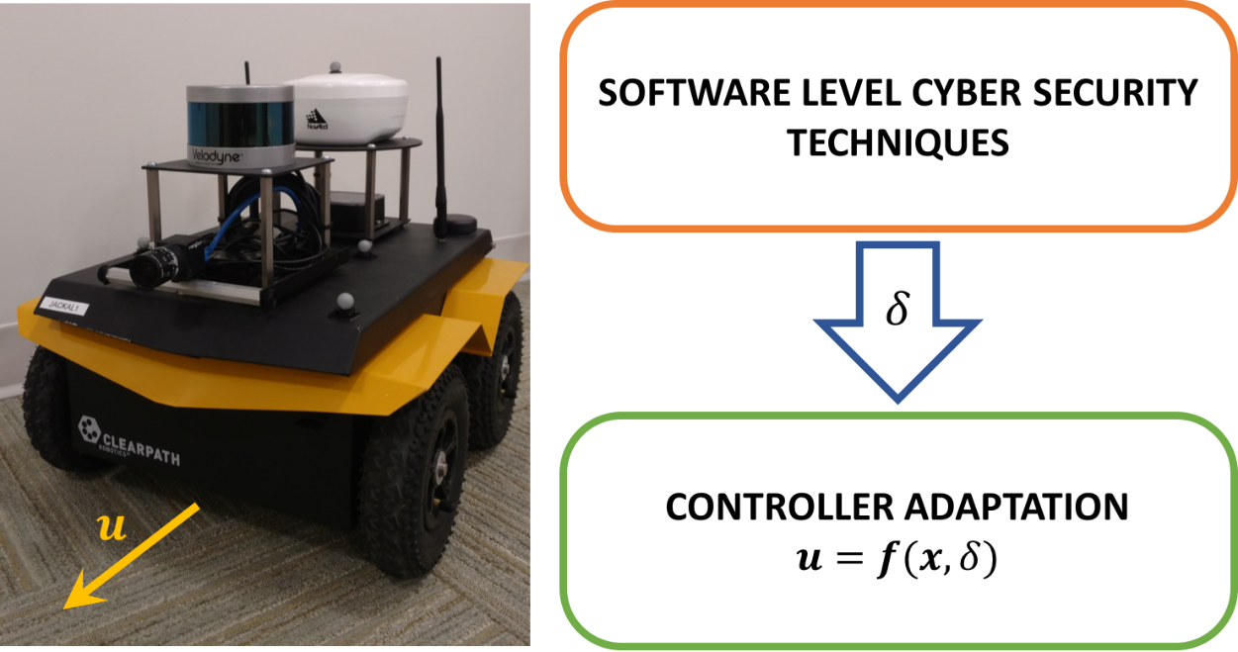
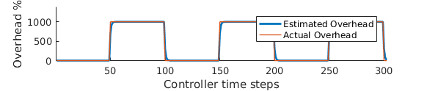
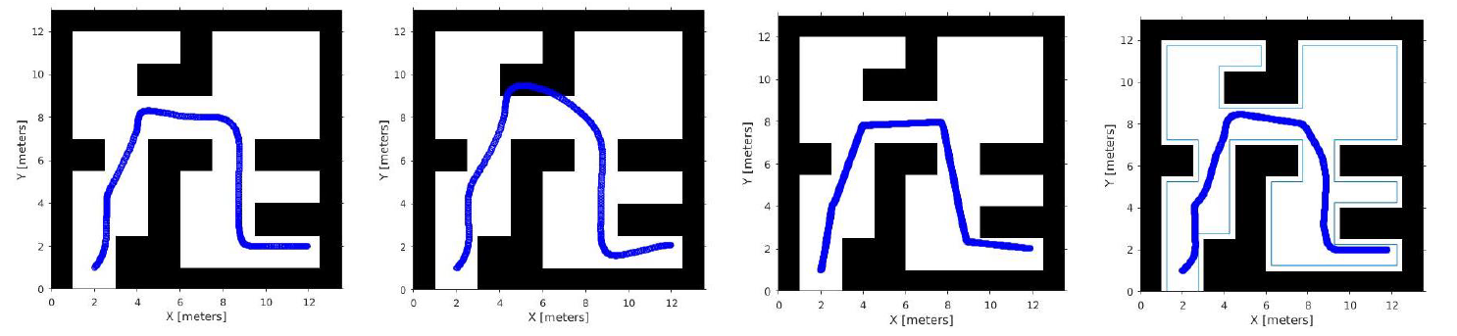
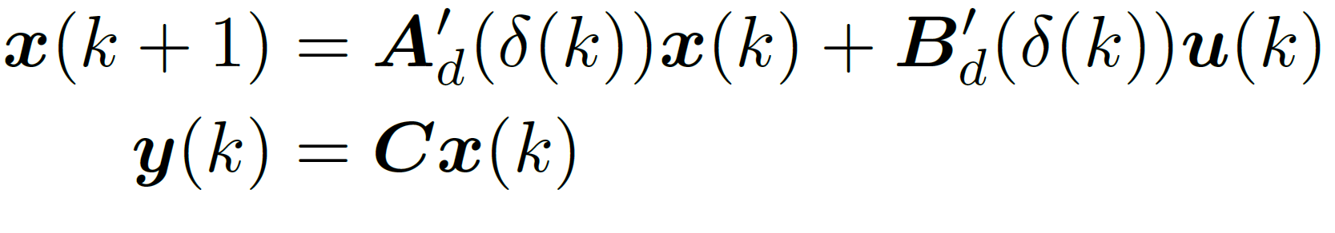
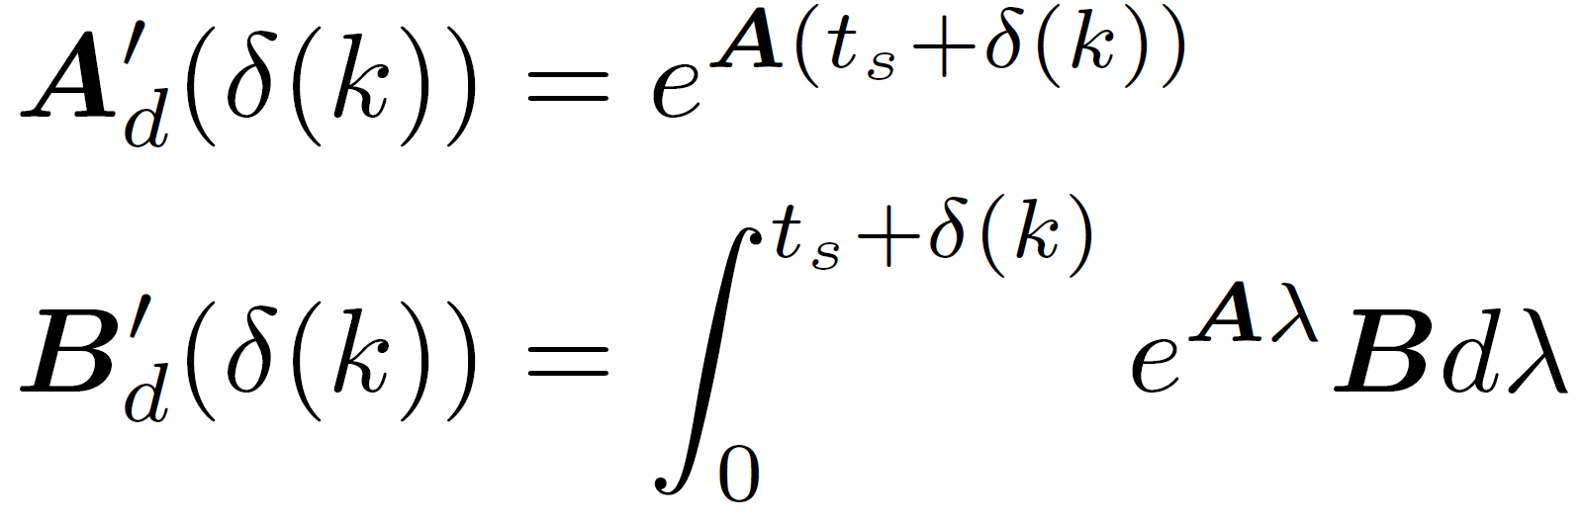
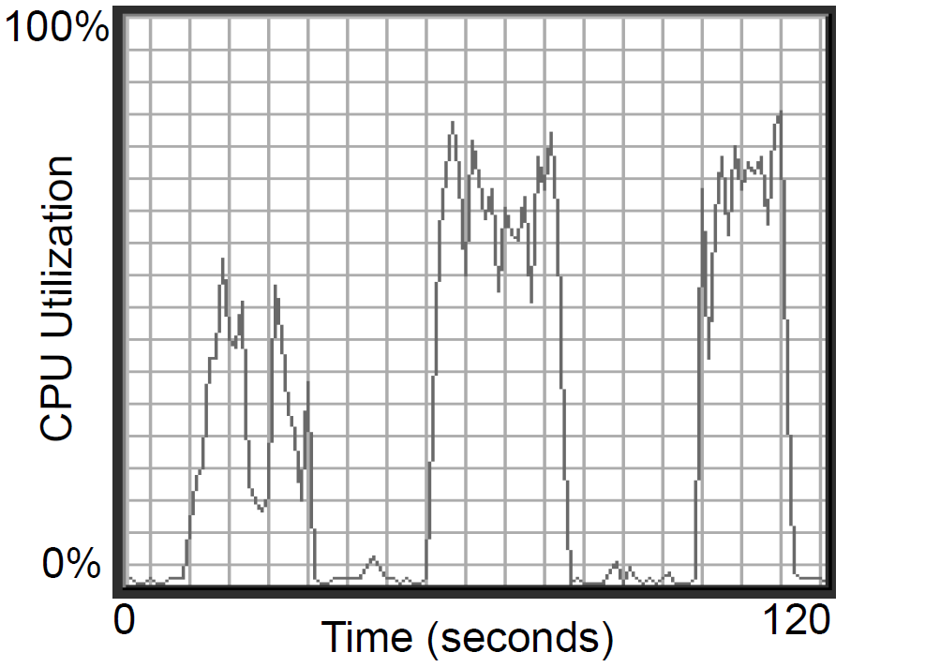
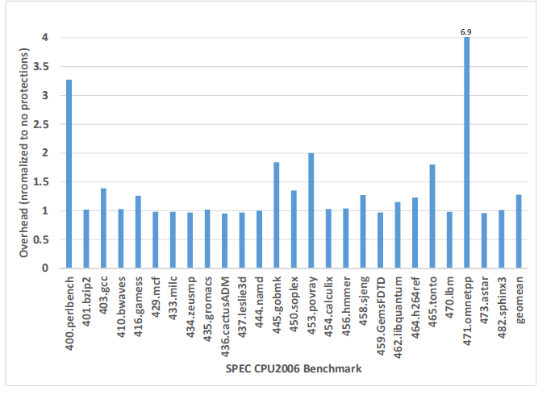
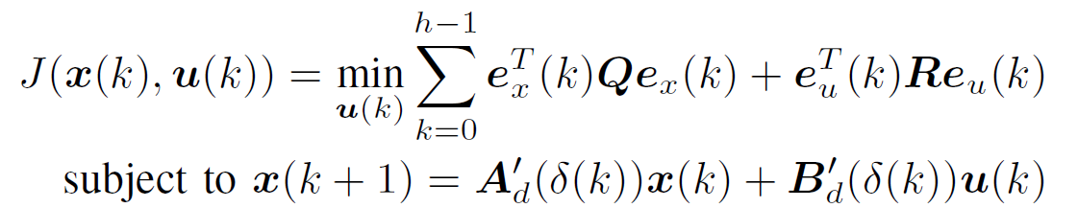
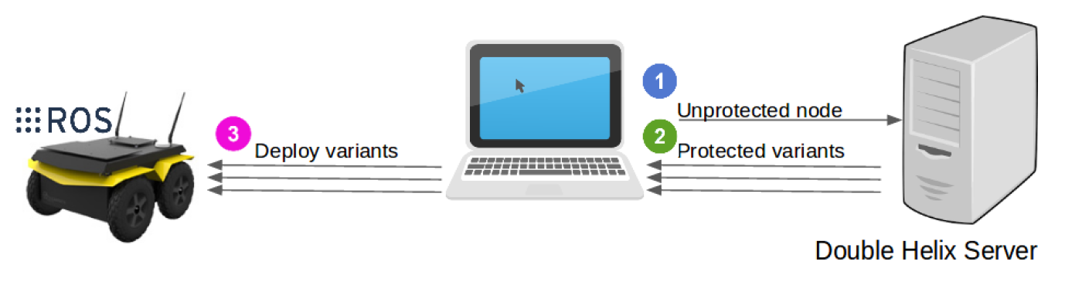
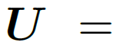
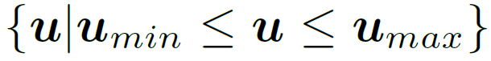
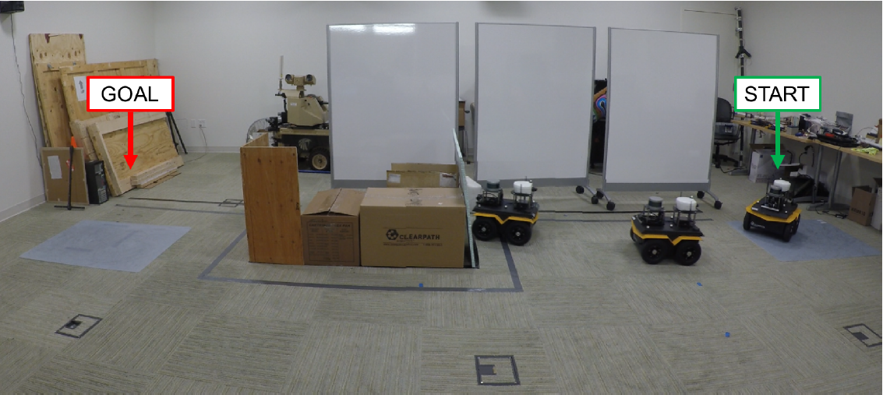
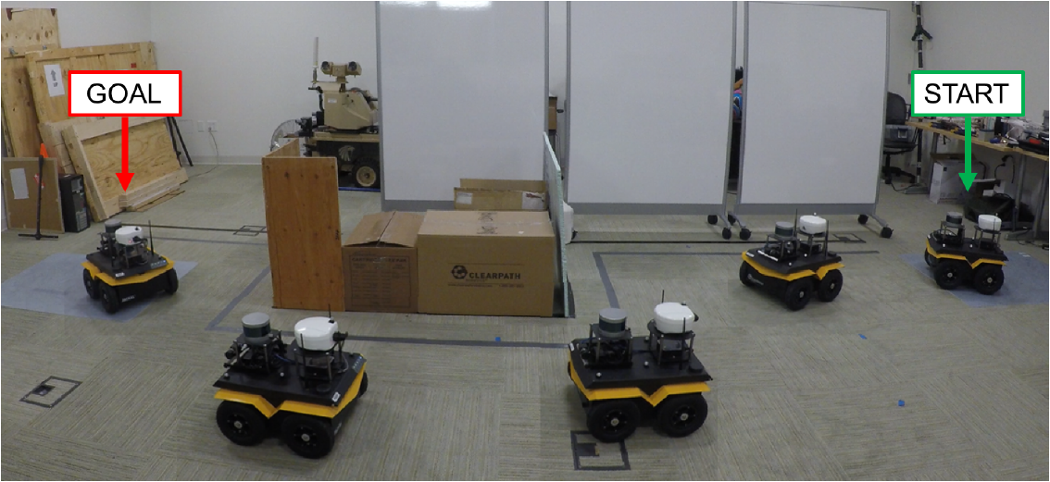
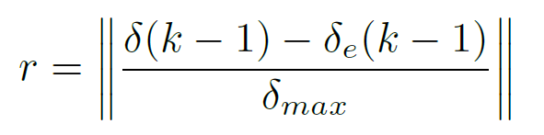
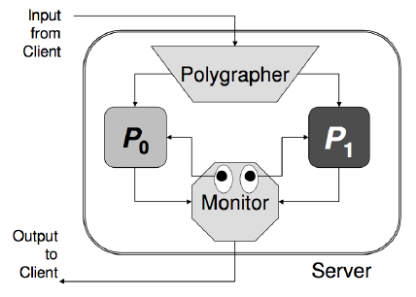
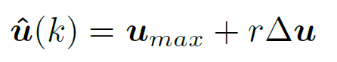
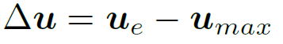
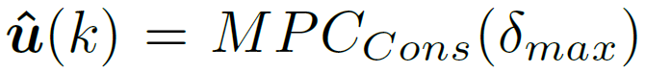


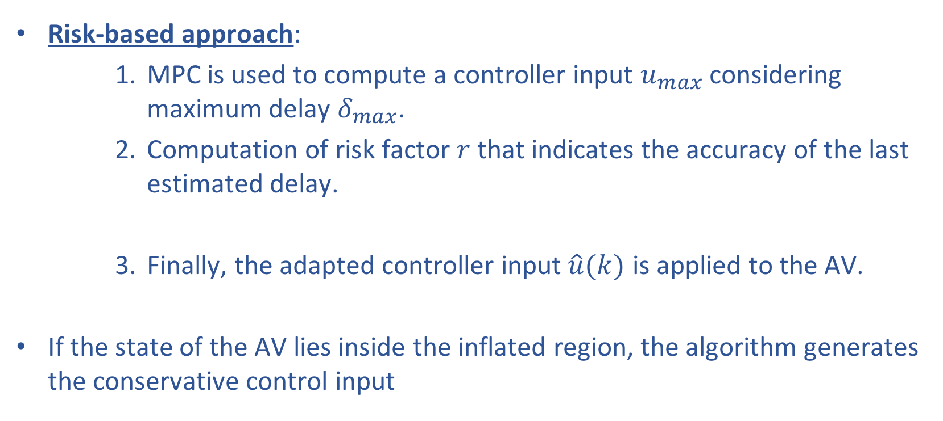
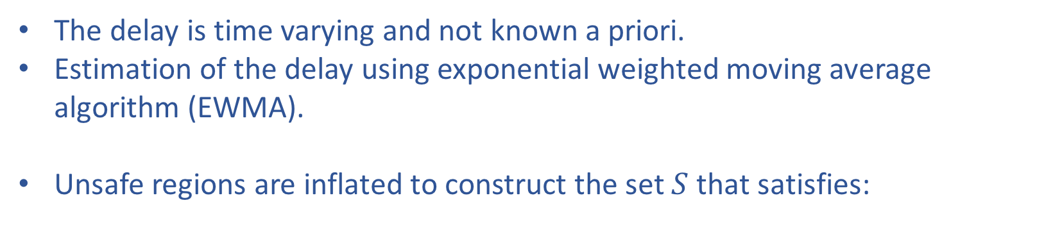
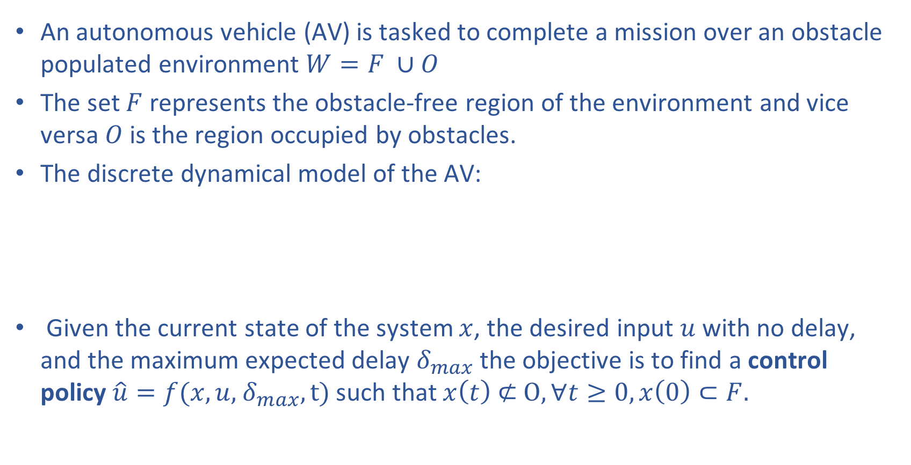
AHS’17
Online Control Adaptation for Safe and Secure Autonomous Vehicle Operations
Mahmoud Elnaggar¹, Jason D. Hiser², Tony X. Lin³, Anh Nguyen-Tuong², Michele Co², Jack W. Davidson², and Nicola Bezzo^{1,3}
¹Department of Systems and Information Engineering, ²Department of Computer Science, ³Department of Electrical and Computer Engineering
University of Virginia
INTRODUCTION
PROBLEM FORMULATION
SIMULATONS
Modern cyber-physical systems are not built with cyber-security in mind.
Adding cyber-security incurs runtime overheads that results in performance degradation and safety issues.
An autonomous vehicle (AV) is tasked to complete a mission over an obstacle populated environment $W=F ∪O$
The set $F$ represents the obstacle-free region of the environment and vice versa $O$ is the region occupied by obstacles.
The discrete dynamical model of the AV:
Given the current state of the system $x$, the desired input $u$with no delay, and the maximum expected delay $δ_{max}$ the objective is to find a control policy $\hat{u}=f(x,u,$ $δ_{max},t)$ such that $x\left(t\right) \text{⊄} O, ∀t≥0, x\left(0\right)⊂F.$
Imposing cyclic controller runtime overheads
CYBER-SECURITY TECHNIQUES
System-level software security techniques:
Anti-virus and intrusion-detection systems.
monitor the entire system for indications of compromise.
Application-level software security techniques:
Control Flow Integrity (CFI):
Instruments the application to enforce the intended control flow at run time.
The overhead on an application varies depending on the inputs it processes.
N-variant system (Double Helix¹):
Employs the systematic application of artificial diversity to prevent large classes of attacks.
Provides formal proofs that certain classes of attacks are not possible and system can recover from attacks and continue operation.
The performance overheads can reach up to 400%.
(a) No Overhead Delay (b) No adaptation (c) Conservative navigation (d) Adaptive navigation
Scenario | Task Execution Time(s)
No overhead | 6.3
Overhead + conservative controller | 43.4
Overhead + online adaptation | 18.1
ONLINE CONTROLLER ADAPTATION
Model Predictive Control (MPC).
EXPERIMENTS
Integrating Software Level Cyber Security Techniques On A Real AV:
Double Helix is used to protect ROS nodes for mapping and navigation.
Performance overhead imposed by the protected controllers reached 30%.
Online Adaptation Control with Unknown Overhead:
The delay is time varying and not known a priori.
Estimation of the delay using exponential weighted moving average algorithm (EWMA).
Unsafe regions are inflated to construct the set $S$ that satisfies:
Type of overhead | Slam_gmapping | Move_base
CPU load | 17.8% | 12.5%
Memory consumption | 3.0% | 2.56%
Risk-based approach:
MPC is used to compute a controller input $u_{max}$ considering maximum delay $δ_{max}$.
Computation of risk factor $r$that indicates the accuracy of the last estimated delay.
Finally, the adapted controller input$\hat{u}(k)$ is applied to the AV.
If the state of the AV lies inside the inflated region, the algorithm generates the conservative control input
Without Adaptation
With Adaptation
CONCLUSION AND FUTURE WORK
Outcome: Trade-off between security, performance, to guarantee safety.
Planned extension to unmanned aerial vehicles (UAVs).
Use Machine Learning techniques to estimate the delays and adapt the controller input accordingly.
¹M. Co, et al., “Double helix and raven: A system for cyber fault tolerance and recovery”, CISRC ’16.
Notes:
TEXT TOO SMALL, at least 24 and titles 32
Consistency with fonts: use calibri everywhere
Not a Motivation but Cyber-security techniques
Problem formulation need to be trimmed down
No need to say ”the online controlelr adaptation uses model predictive control..instead say MPC to calculate the sequence of inputs
Delay is time varying and not known a priori
Estimation of delay using EWMA
Unsafe region sentence do not make sense ???? Add figure on the side of the equation
Last column: Remove Simulations and Experiemnts and just put Simulations and then experiments
Shrink the table…too much space
Remove ”we” ..it’s a poster…go doirectly to the point
What’s ML?
Add delay patetrn near figure of delay in simulation
Add titles on each snapshot

